Slide 1
Multimodal Logical Inference System for Visual-Textual Entailment
Riko Suzuki, etc
ACL 2019 Student Research Workshop
Notes:
Good afternoon, everyone. Today I’ll talk about a paper that try to solve the visual-textual entailment problem. It was accepted by ACL 2019 student workshop.

Slide 2
Outline
Introduction
The multimodal logical inference system
Represent an image
Unify image and text
Logical inference
Experiment
Conclusion
Notes:
In this talk, I’ll firstly give the problem definition and its challenges in the introduction. Then I’ll introduce the system in detail. The evaluation of the system will be shown in the experiment part and finally the conclusion.

Slide 3
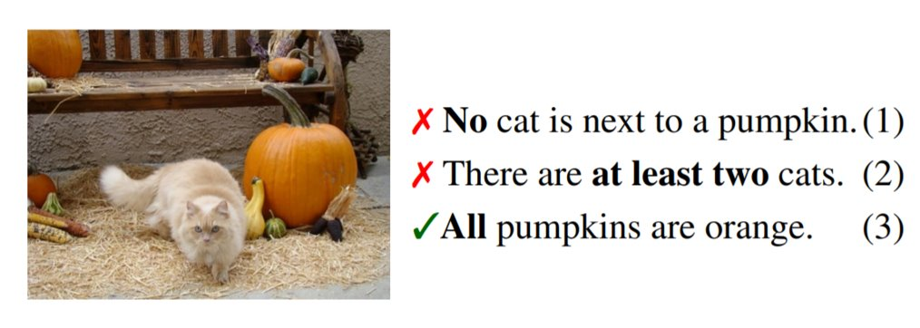
Introduction
Visual-Textual Entailment problem
Given an image g and a statement s, check whether the statement is true or false under the situation described in the image.
Notes:
A visual-textual entailment problem is that given an image g and statement s, we need to check whether the statement is true of false under the situation described in the image. For example, the statement one, no cat is next to a pumpkin is false because we can see an adorable cat next to the big pumpkin. For other statements, you can quickly verify the correctness.

Slide 4
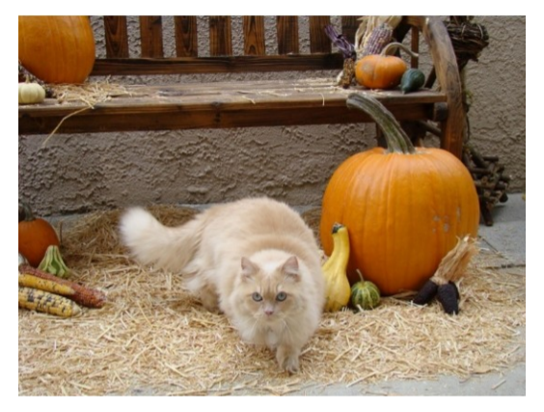
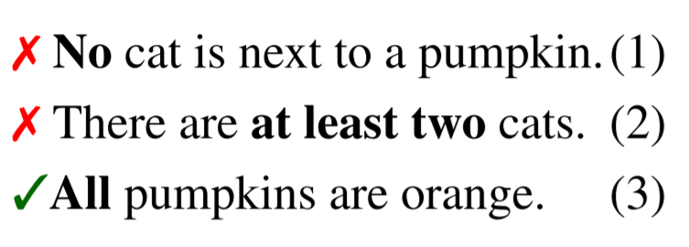
Introduction - challenges
How to represent an image ?
Embed image into high-dimensional vector space.
Use structural representations graph for image.
How to unify image data and text data ?
That’s why we call ‘multimodal’
How to capture complex logical meanings ?
Negation, quantification, etc
How to perform logical inference ?
Notes:
But for machine, the problem is not that easy. The first challenge is how to represent an image for a machine to capture its information. One possible method is to embed the image into high-dimensional vector space. But it is not interpretable. Another possible method is to use structural representations graph, which is the choice of this paper. The second challenge is how to unify image and text data. As we know, image is continuous data while text is discrete. They are different and that’s why we call ‘multimodal’. The third challenge is to capture the complex logical meanings, say negation, quantification, etc. Statement one is kind of negation and statement three is quantification in the example. And the final one is how to perform logical inference.

Slide 5
Outline
Introduction
The multimodal logical inference system
Represent an image
Unify image and text
Logical inference
Experiment
Conclusion
Notes:
Now let’s see how the author attack these challenges step by step.

Slide 6

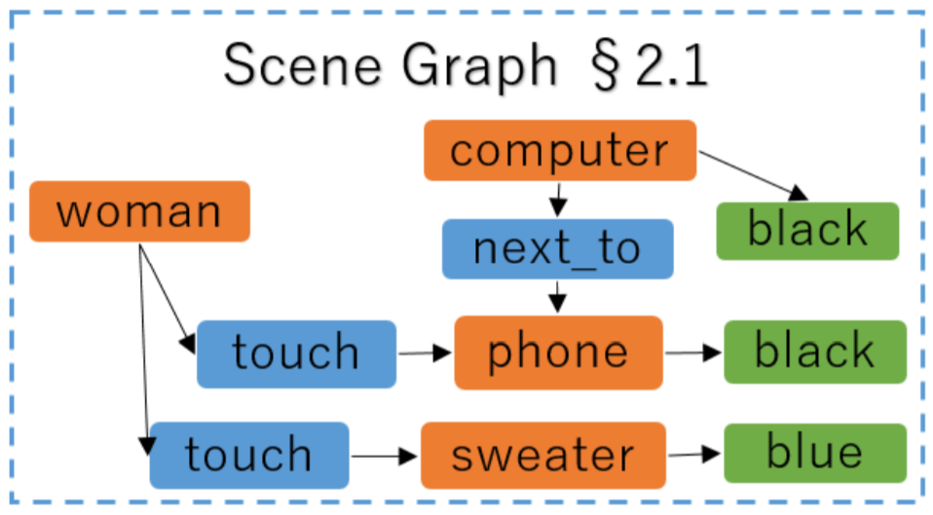
Represent an image
Scene Graph
A graphical representation that depicts objects, their attributes, and relations among them occurring in an image.
Nodes := object with their categories
Edges := relationships between objects.
In this paper, the scene graph was given by the dataset !
Notes:
There’re two methods to represent an image in this paper. The first one is called scene graph. It is a graphical representation that depicts objects, their attributes, and relations among them occurring in an image. The nodes in the graph are object with their categories. The edges are relationships between objects. To build this kind of graph is another difficult topic in computer vision area. In this paper, the scene graph was given by the dataset.

Slide 7
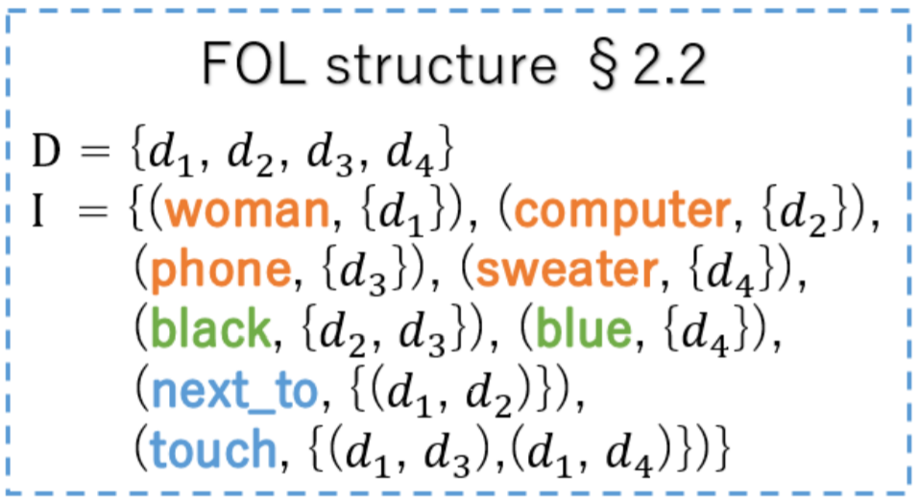
Represent an image
FOL Structure
Represent semantic information in images.
An FOL structure is a pair (D, I) where
D := a domain consisting of all the entities in an image
I := an interpretation function that maps 1-place predicate to a set of entities, and a 2-place predicate to a set of pairs of entities, and so on
Notes:
The second one is FOL structure. FOL stands for First Order Logic. It can represents semantic information in an image. An FOL structure is a pair (D, I) where balabala.

Slide 8
Outline
Introduction
The multimodal logical inference system
Represent an image
Unify image and text
Logical inference
Experiment
Conclusion

Slide 9

Unify image and text
?
Inference
Notes:
As we mentioned before, image data and text data are in different dimension. So here comes the quiz. How to unify the image and text data ? You can make a brave guess. The hint is I just mention it before.

Slide 10
Unify image and text
?
Quiz: how to unify the image data and the text data ?
Inference
Notes:
As we mentioned before, image data and text data are in different dimension. So here comes the quiz. How to unify the image and text data ? You can make a brave guess. The hint is I just mention it before.

Slide 11
Unify image and text
Semantic Parser
Graph translation
Logical Formula
Inference
Notes:
The answer is you can embed the graph and text data into high dimensional vector space by some NN model. But in this paper, the author pursue interpretability for the inference problem. So they unify image and text data into logical formula, by graph translation and semantic parser respectively.

Slide 12
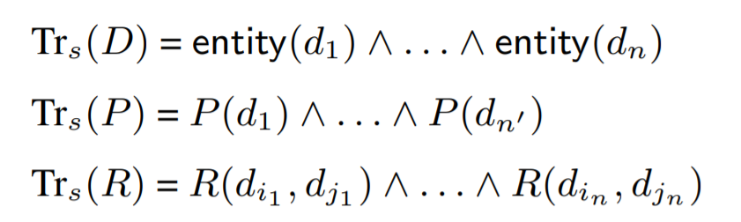
Unify image and data
Graph translator
Simple translation: simply conjoins all the atomic information
E.g. : man(d_1), hat(d_2), red(d_2), wear(d_1, d_2)
=> man(d_1) /\ hat(d_2) /\ red(d_2) /\ wear(d_1, d_2)
Not capture the information that d_1 is the only entity that has the property man.
Notes:
In this paper, the author propose two kinds of graph translator. The first one is called simple translation.

Slide 13
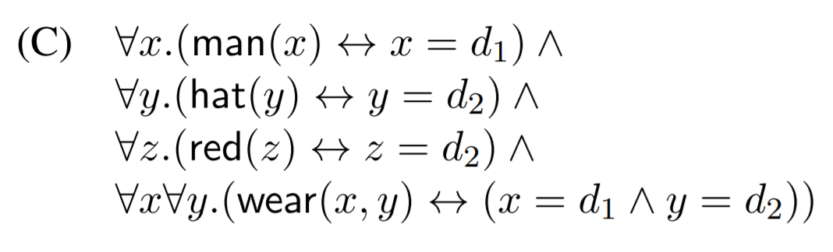
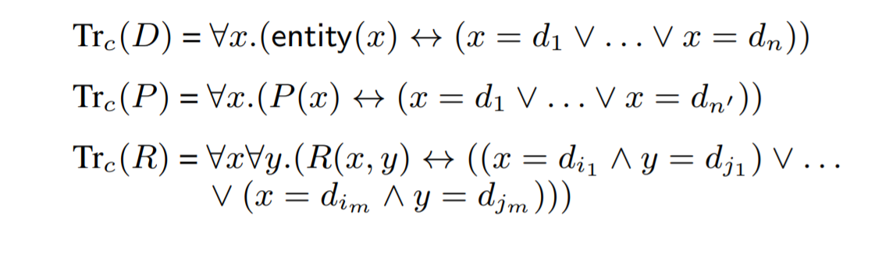
Unify image and data
Graph translator
Complex translation:
E.g. :
Notes:
To handle the complex semantic like negation and quantification, they gave complex translation.

Slide 14
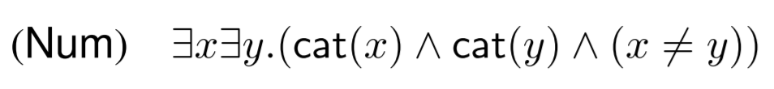
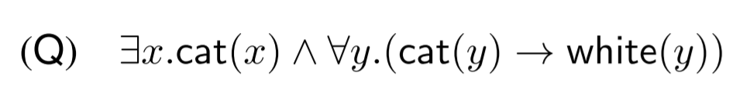
Unify image and data
Semantic Parser
Apply ccg2lambda, a semantic parsing system based on CCG to convert sentence to formulas.
Extend the system to handle numerals and quantificational sentences.
E.g. : There are (at least) two cats.
All cats are white.
Notes:
How to do that and how to extend ? Not mention.

Slide 15
Outline
Introduction
The multimodal logical inference system
Represent an image
Unify image and text
Logical inference
Experiment
Conclusion

Slide 16

Logical Inference
Theorem prover is a method for judging whether a formula M entails a formula T.
Use Prover9 as an FOL prover for inference.
Set timeout (10 sec) to judge that M doesn’t entail T.

Slide 17
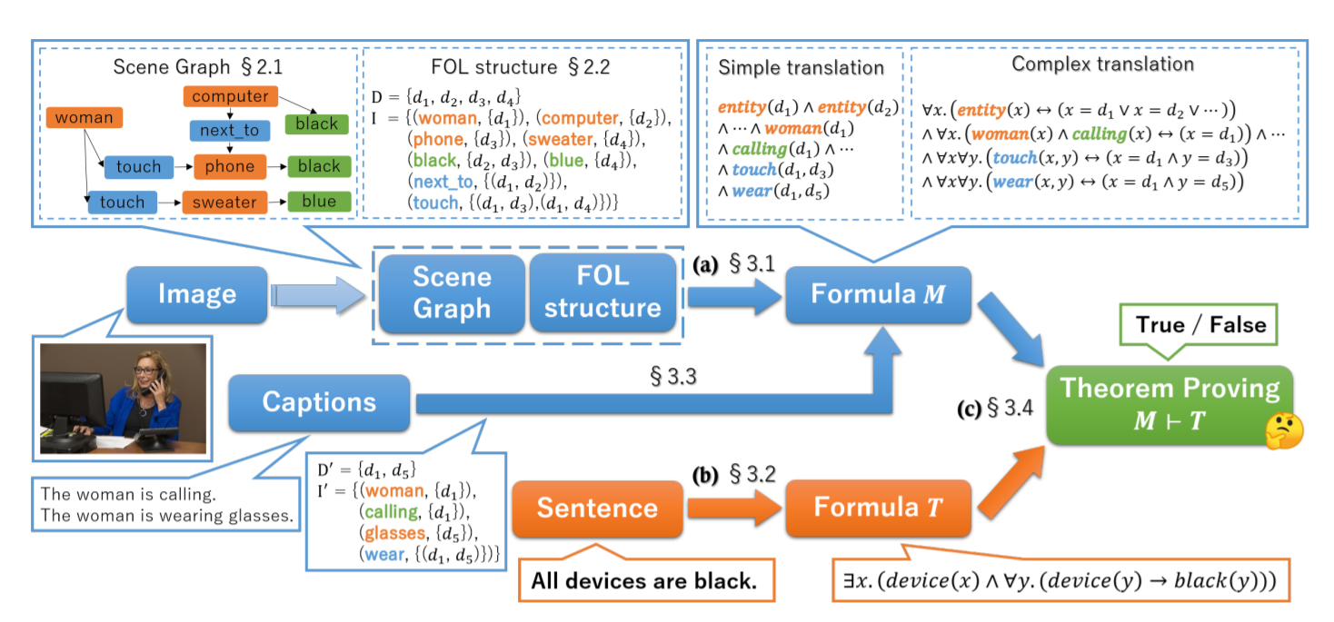
Summary for the system

Slide 18
Summary for the system
Quiz: Which of the following component is proposed by the author ?
A. Scene graph and FOL B. Prover9
C. Graph translation D. CCG semantic parser

Slide 19
Experiment
Formulate the task as image retrieval
using query sentences and evaluate the performance in terms of the number of correctly returned images.
Prepare sentence templates for creating query
Five types of linguistic phenomena.
Logical connective (Con), numeral (Num), quantifier (Q), relation (Rel) and negation (Neg).
Dataset:
GRIM (annotated by FOL structure)
Visual Genome (scene graph)

Slide 20
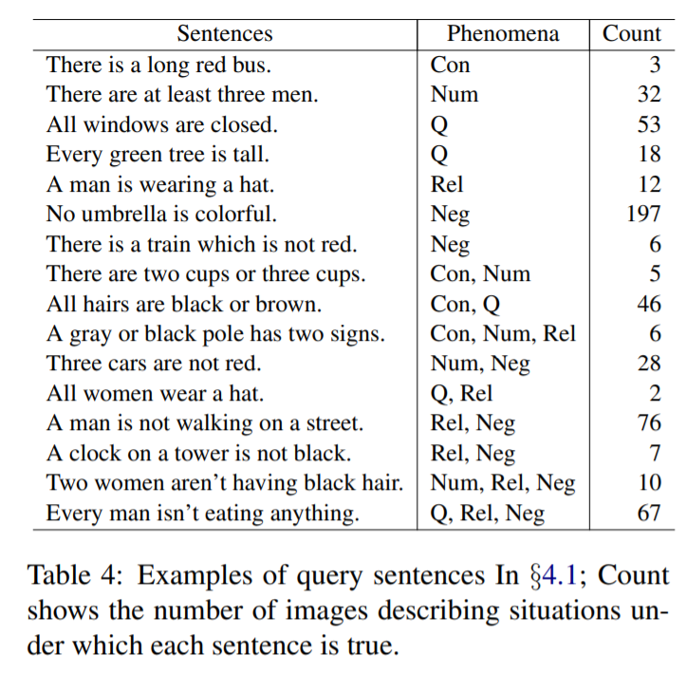
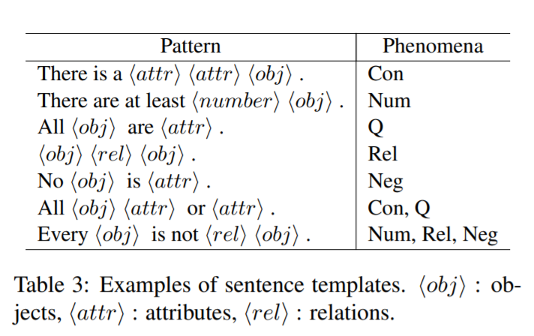
Experiment
Query template and example

Slide 21
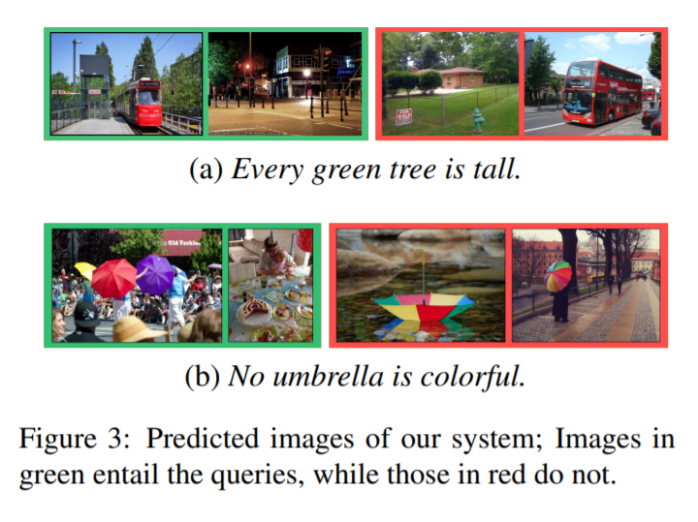
Experiment
Selective results

Slide 22
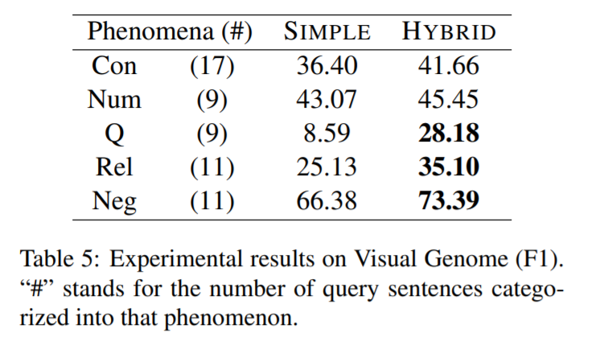
Experiment
Image retrieval F1 score
Complex graph translation helps
Why (Q) low performance ?
Quantifiers in natural language often involves vagueness.
Why (Rel) low performance ?
Lexical gap between formulas of a query and an image.
Notes:
For example. All woman wear a hat and all women have a hat are the same in their meaning. If the scene graph contains only wear relation, it can not handle the second query.

Slide 23
Conclusion
Proposed a logic-based system to achieve visual-textual inference
The system can deal with semantically complex sentences
The system is traditional and doesn’t require supervised data.
Comment
Pros :
Proposed a non-NN system to solve the inference problem.
The system is clear and the solving procedure is interpretable.
Cons:
four key component of the system, only one is proposed by the author.
Lack of comparison experiment with some other baseline models.

Slide 24
Thank you :)

